Slide 1






CAMPUS EVENT REGISTRATION SYSTEM
TEAM 1

Slide 2

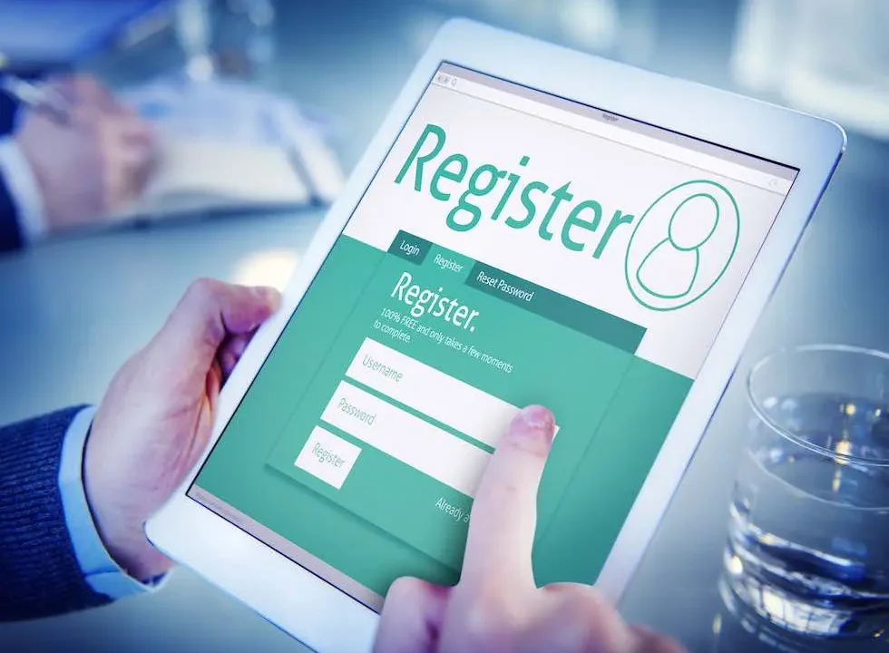
EventNest
Meet EventNest - a campus event registration solution created specifically for college-going students.
EventNest enables students to:
  Access all campus events in one place
  View event information such as date, time, location, and description
  Register using their college identity
  Create a personal event calendar so they never miss what they have registered for
Organizers will finally get accurate and confirmed registration information. Students will get clarity and convenience.

Slide 3
Value & Impact
What makes EventNest different from social media or emails?
  Structured System - It’s not only announcements, but registrations too
  Student - Specific Access – Safe sign-ups for users Improved Planning for
  Organizers - Know the numbers in advance Improved Experience for
  Students - All in one place, no confusion

